Slide 1
Networking and The Internet
Discussion: Do you ever ‘disconnect’ from the internet? Is that even needed?

Slide 2
Review
Operating Systems – programs that help manage resources on computers
particularly files
devices (printers, monitors, input/output)
ssh – secure shell that allows you to connect to computers remotely
cd/ls/mkdir/ - various programs that interact with the file systems
nano/pico - text editors on linux systems
But how does the internet and networking work?

Slide 3
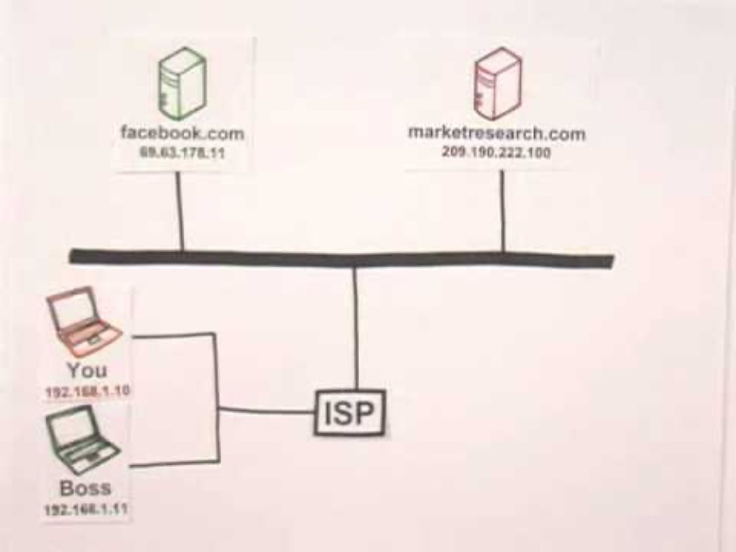
How the Internet Works in 5 Minutes

Slide 4
Details to know
Computers have addresses
Internet Protocol (IP) Address
Using Domain Name Servers – we can map these IP to names.
Web pages are simply files
passed between computers!
Understanding how file systems work => critical for understanding websites work
Next up
ssh into your “favorite” CS machine
Follow along with the TA
> ssh ename@denver.cs.colostate.edu
> ssh ename@boston.cs.colostate.edu

Slide 5
Testing Networks
ping - try it!
checks to see how long it takes to send a very small file to a machine, and get a response
ping colostate.edu
control-c to stop it, as it keeps running unless you say otherwise (note: ping is also on windows machines)
ping google.com
ping cnnic.com.cn
traceroute (tracert on windows)
gives you the route a file takes to get to its destination
traceroute colostate.edu
traceroute google.com
wait, where is that going?!? Isn’t google in California? Discuss what is going on

Slide 6
Coding Challenge
> javac HelpSession10.java
compiles your class
> java HelpSession10
runs your java program
We often have to encode/compress information to reduce the amount sent!
speeds up traffic, and less costly
Using the command line (pico/nano)
Write a loop that counts the ‘number of changes’ in a String array. For example
[“a”, “a”, “a”]
0 changes
[“aa”, “aa”, “ab”]
1 change
[“aa”, “bb”, “ba”, “aa”]
3 changes
To do this you must look at the ‘previous’ or last String!
Code with a partner on it!
The TA will present a solution

Slide 7
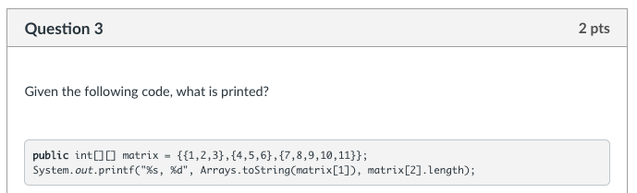
Knowledge Check

Slide 8
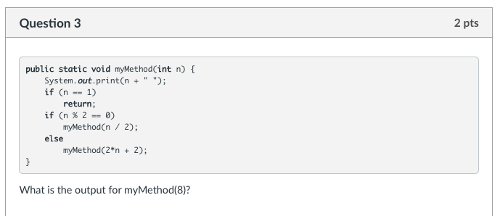
Knowledge Check

Slide 9
More Questions for TAs
Stuck on any challenge problems?
Working on the practical and stuck on the logic?
Not your code, but the algorithm / discussion
Now it the time to ask it!

